Slide 1
Vacations
Hawaii
Suttons Bay
Chicago
Colorado
Boston
New Mexico

Slide 2
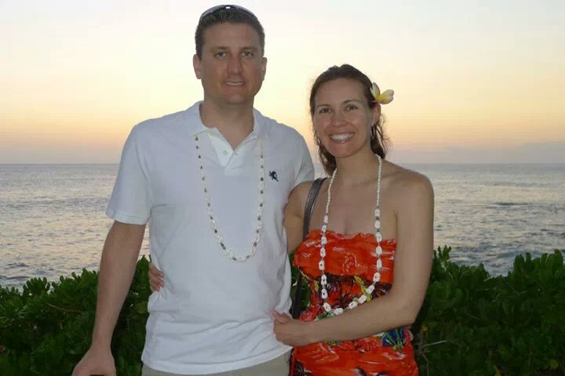
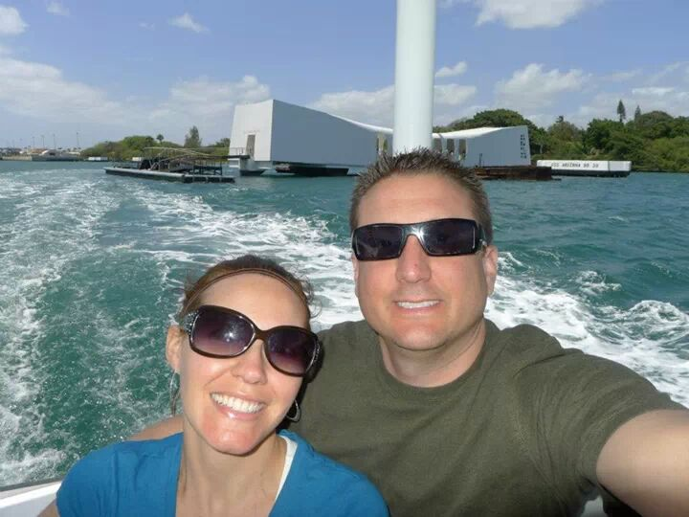
Honolulu and Waikiki Beach
Spring Break
My husband
First Class Surprise
Amazing weather (upper 70’s every day)
Snorkeling
Whale watching
Firework Cruise
Sunset Cruise
Hike up Diamond Head
Pearl Harbor
Swimming in Ocean and Pool
Amazing restaurants
TheBus
Long Flight (10 and a half hours)
Sunset and Pearl Harbor

Slide 3
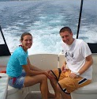
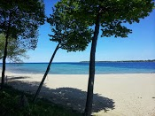
Suttons Bay
By Traverse City
Condo on water
Husband and family
Boating
Swimming
Relaxing/reading
Boat Ride!
Beach at the Condo!

Slide 4
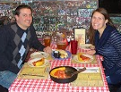
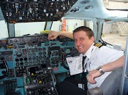
Chicago
First Flight
Deep dish pizza
Lake Michigan
Hershey Store
Downtown
Winter and Summer

Slide 5
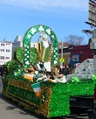
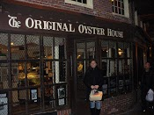
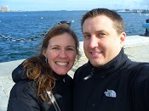
Boston
St. Patrick’s Day Parade
Cheers
Harvard
Boston Harbor
Oldest restaurant in America
History

Slide 6
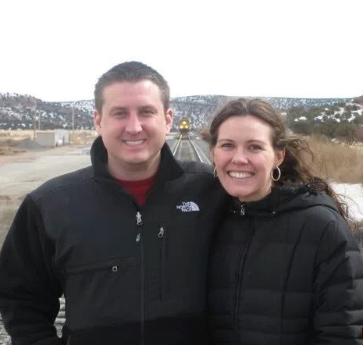
New Mexico
House on mountain
Monster Jeep
Canyon drives
Sandia Peak Tram
Owl Bar
Pete’s Mexican

Slide 7
Colorado
Map
Activities
Pictures
If you are just picking one place you’d do it like this.
People
Climate
Culture
When

